Slide 1
MAPHEAL
By Jan, and Yoon

Slide 2
What is the application “map heal”?
Users can QUICKLY and FASTLY find health-related information.
Avoid any other diversion while looking for health and wellness-related items.
Owners of businesses can also register them with our program so that their locations will show up on the map.

Slide 3
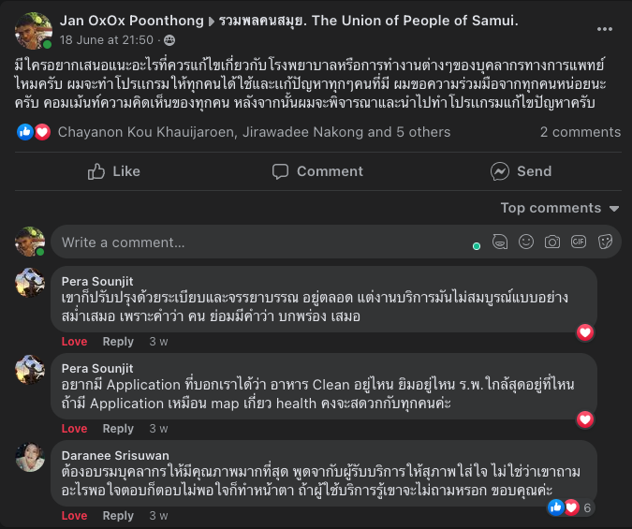
How did we come up with this idea?

Slide 4
Who are our target users?

Slide 5

What are we trying to solve (Pain Point)?

Slide 6
- access to just health-related information on the map - not to include unneeded spots in the complexity of a map - For all users, it is basic and easy to use.

Slide 7
WHAT ARE THE PROS AND CONS?

Slide 8
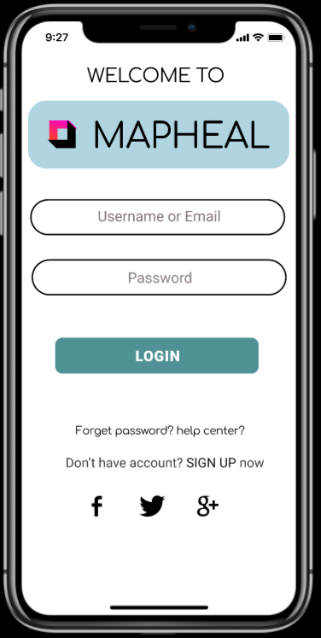
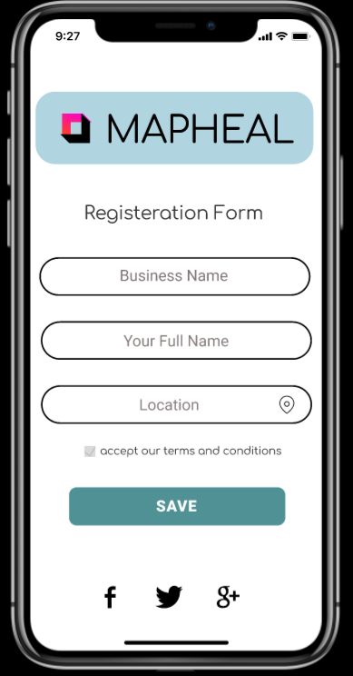





For business owners
For users
Having pros for two parties

Slide 9
unique value proposition (UVP)
Easy to find health related services or products.
Minor distractions while searching for health-related stuff.
Hot and Trending suggestion.

Slide 10
Improvement goal
Not user friendly yet. WORKING PROCESS
Can’t see the direction to the place yet. WORKING PROCESS

Slide 11
Who it is useful for?
Elderly people
Athletes
People like on Facebook post (Maybe working-class person or person who take serious about their)
Fighters or Boxers

Slide 12
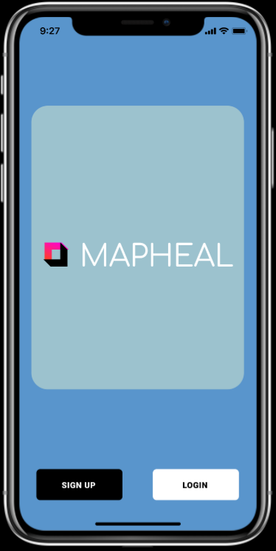
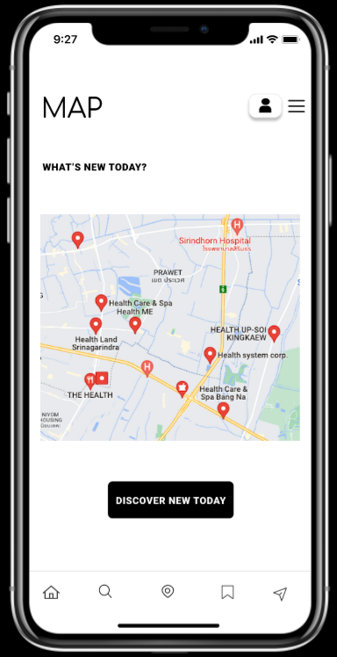
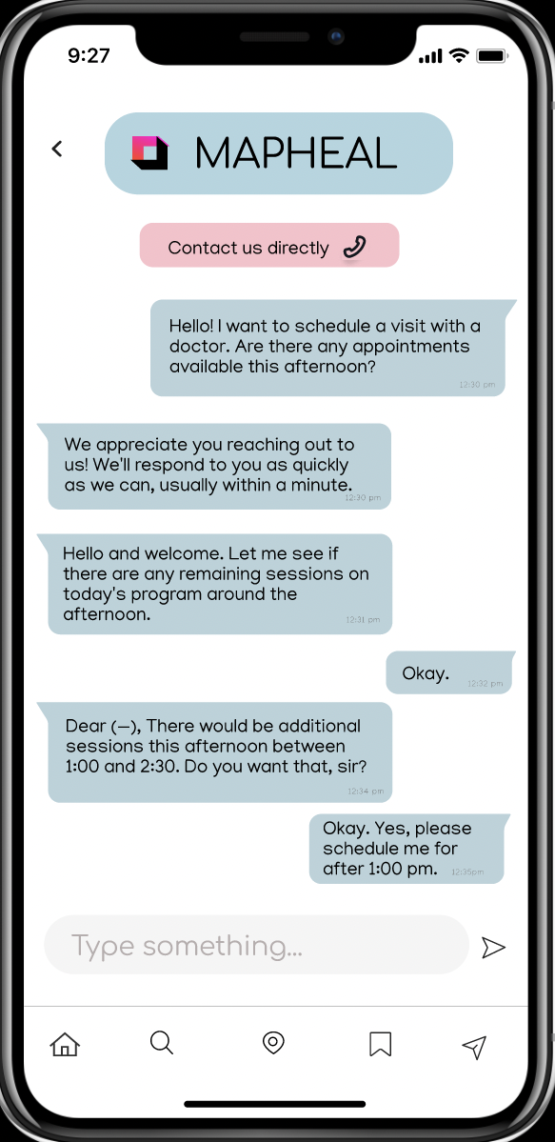


Wireframe
Home page
Map displaying primarily medical facilities and other associated sites
Users can set up “chat appointments” with their preferred hospitals.

Slide 13
"Prototype”
https://www.figma.com/proto/XkIFlUincTAV0k3053fJHU/Prototyping-in-Figma?node-id=0%3A2&scaling=scale-down&page-id=0%3A1&starting-point-node-id=0%3A2

Slide 14
THANK YOU
By Jan Poonthong(6511286) and Yoon Waddy Myo Myint(6511566)

